Slide 1
HPTN 078: Primary results of a randomized study to engage men who have sex with men (MSM) living with HIV who are virally unsuppressed in the USA
Chris Beyrer, Chair
Robert H. Remien, Co-Chair

Slide 2
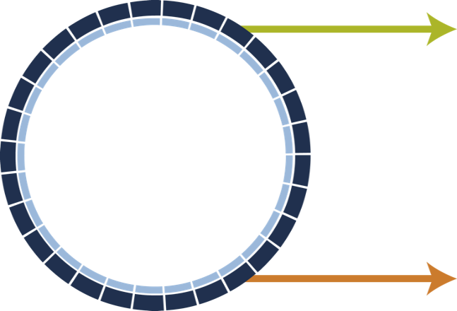
HPTN 078: Enhancing Recruitment, Linkage to Care and Treatment for HIV-Infected Men Who Have Sex with Men (MSM) in the United States
Study Design, Population, Duration
Screened population | Enrolled participants
1305 | 144
MSM and TGW >= 16 yo | MSM and TGW HIV+, Unsuppressed
Study Duration: 12 Month Follow-up
Intervention
(n = 72)
Enhanced Case Manager Intervention
MSM, HIV+
Unsuppressed
Control
(n = 72)
SOC for Linkage and Treatment
Deep-Chain Respondent Driven Sampling (DC-RDS)
AND
Direct Recruitment
Individual Randomization

Slide 3
Screening (1305) and Enrollment (144) (How We Found Them)
 | Birmingham | Boston | Baltimore | Atlanta | Total
Screened: DC-RDS (all > Wave 0) | 203 | 198 | 183 | 137 | 721
Screened: DR (includes seeds) | 263 | 90 | 98 | 133 | 584
Enrolled (DC-RDS/DR [Total]) | 3/31 [34] | 14/13 [27] | 19/16 [35] | 21/27 [48] | 57/87 [144]
Screening to Enrollment Ratio (DC-RDS) | ~68 : 1 | ~14 : 1 | ~10 : 1 | ~7 : 1 | ~13 : 1
Screening to Enrollment Ration (DR) | ~8 : 1 | ~7 : 1 | ~6 : 1 | ~5 : 1 | ~8 : 1
Most screened via DC-RDS, but more enrolled via DR
154 (12%) were found to be HIV+ and unsuppressed, 144 (94%) enrolled

Slide 4
Sociodemographics (Who We Found)
 | DC-RDS (N=721) | Direct Recruitment (N=584) | Overall N=1305 | Enrolled N=144
 | N (%) | N (%) | N (%) | N (%)
Age (Median, IQR) | 41 (30, 52) | 41 (30, 52) | 41 (30, 52) | 39 (29, 49)
Gender (self-reported) Male Transgender Female | 695 (96) 17 (2) | 545 (93) 29 (5) | 1240 (95) 46 (4) | 139 (97) 3 (2)
Race Black White Other | 448 (62) 179 (25) 99 (13) | 457 (78) 84 (14) 56 (8) | 905 (69) 263 (20) 165 (11) | 121 (84) 19 (13) 4 (3)
Education Less than high-school diploma Beyond high-school | 92 (13) 629 (87) | 100 (17) 484 (83) | 192 (15) 1113 (85) | 15 (10) 129 (90)
Income Low Income (<$20,000) | 476 (66) | 409 (70) | 885 (68) | 93 (65)
Most screened & enrolled were Black, educated and poor

Slide 5
Health Status
 | DC-RDS (N=721) | Direct Recruitment (N=584) | Overall N=1305 | Enrolled (N = 144)
 | N (%) | N (%) | N (%) | N (%)
Received Treatment for Substance Abuse | 147 (20) | 116 (20) | 263 (20) | 20 (14)
HIV Positive Suppressed Viral Load | 417 (58) 330 (79) | 485 (83) 380 (78) | 902 (69) 710 (78) | 144 (100) (none)
Syphilis Co-infected with HIV | 129 (18) 112 (87) | 150 (26) 142 (95) | 279 (21) 254 (91) | 51 (35) (same)
Hepatitis C (Antibody Positive) | 147 (21) | 99 (17) | 246 (19) | 22 (15)
Health coverage Yes No | 613 (85) 107 (15) | 482 (83) 101 (17) | 1095 (84) 208 (16) | 116 (81) 16 (19)
Majority had access to health care, most who were HIV+ were virally suppressed,
High rates of HCV and syphilis

Slide 6
Health Status
Percentage of Participants

Slide 7
Did We Find the Remaining 10%?
Of the 154 screened who were HIV+ and unsuppressed, 89% reported having tested HIV-positive in the past.

Slide 8
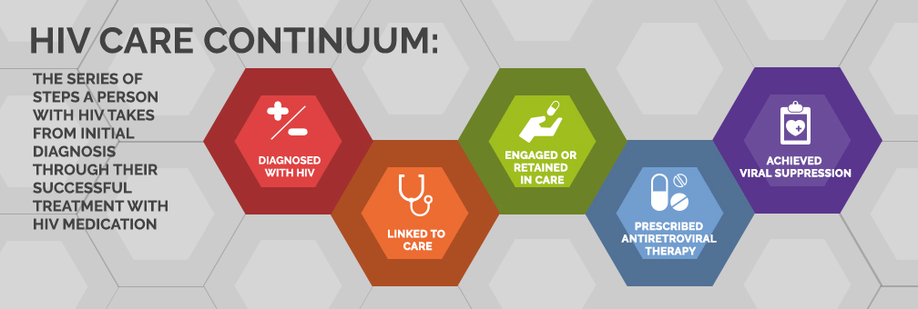
HPTN 078 aimed to strengthen the HIV Care Continuum for MSM
For their own health and to prevent further HIV transmission

Slide 9
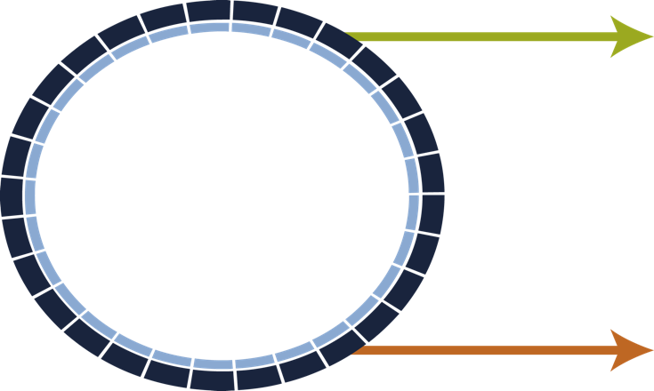
Enhanced Case Manager (CM) Intervention
Site Standard-of-Care for Linkage and Treatment
Control
I need help.
MSM+
CM
How much?
Offer:
weekly visits
daily SMS
Face-to-face
meetings
HIGH
e.g.:
Linkage
assistance
monthly visits
weekly SMS
MEDIUM
Enhanced
CM Intervention
12 months
ART adherence
counseling
quarterly and
semiannual visits
no SMS
LOW
Appropriate
referrals
The enhanced CM intervention includes patient choice, motivational interviewing and automated phone/email/text messages

Slide 10
Sociodemographics
 | Enrolled N=144 | CM Arm N=72 | SOC Arm N=72
 | N (%) | N (%) | N (%)
Age (Median, IQR) | 39 (29, 49) | 39 (29, 49) | 39 (29, 49)
Gender (self-reported) Male Transgender Female | 139 (97) 3 (2) | 71 (99) 1 (1) | 68 (94) 3 (4)
Race Black White Other | 121 (84) 19 (13) 4 (3) | 62 (86) 9 (13) 1 (1) | 59 (82) 10 (14) 3 (4)
LatinX | 10 (7) | 3 (4) | 7 (10)
Education Less than high-school diploma Beyond high-school | 15 (10) 129 (90) | 7 (10) 65 (90) | 8 (11) 64 (89)
Income Low Income (<$20,000) | 93 (65) | 48 (67) | 45 (63)
Not employed | 97 (67) | 48 (67) | 49 (68)

Slide 11
Baseline Health
 | Enrolled (N = 144) | CM Arm N=72 | SOC Arm N=72
 | N (%) | N (%) | N (%)
Received Treatment for Substance Abuse | 20 (14) | 8 (11) | 12 (17)
Syphilis | 51 (35) | 27 (38) | 24 (33)
Hepatitis C (Antibody Positive) | 22 (15) | 15 (21) | 7 (10)
Health coverage: Yes | 116 (81) | 59 (82) | 57 (79)
Mean CD4 Cell Count | 357 | 337 | 377
Previously taken ART to treat HIV | 124 (86) | 64 (89) | 60 (83)
Majority had access to health care, high rates of HCV and syphilis

Slide 12
Retention
91% were retained at Month 12

Slide 13
Viral Suppression (<200) by Arm and Visit
 | Overall | CM Arm | SOC Arm
Month 3 | 41 (28%) | 20 (28%) | 21 (29%)
Month 6 | 52 (36%) | 26 (36%) | 26 (36%)
Month 9 | 56 (39%) | 28 (39%) | 28 (39%)
Month 12 | 68 (48%) | 30 (42%) | 38 (54%)
At baseline, the median viral load was 19,459 copies/mL, and at Month 12, 48% were virally suppressed, with no difference between the CM and SOC arms (OR = 0.615 [p = 0.1526, 95% CI = 0.315, 1.197]).

Slide 14
Why Didn’t the CM Intervention Show a Difference? Potential Reasons
SOC provided similar level/type of support; the CM intervention was not distinct enough from SOC
Participants did not want or perceive a need for the CM intervention
There was a gap between the availability of the VL data and the CM sessions
More medically-focused counselors are required
The CM intervention could not overcome structural barriers (e.g., stigma, racism, insensitive care)
The CM intervention was not adequately implemented
The CM intervention components were not the right ones, nor sufficient to overcome participant challenges
Other reasons

Slide 15
Key Messages
Both DC-RDS and DR worked to find the target population
~1300 MSM, mostly Black, poor and educated
Most were HIV positive (69%) and virally suppressed (78%)
Most knew they were positive and successfully engaged in care
12% were HIV positive, but unsuppressed
Almost all (94%) were willing to enroll (re-engage in care)
The vast majority (89%) already knew their HIV+ status
Despite access to health care, there were high levels of HCV and syphilis

Slide 16
Key Messages
MSM living with HIV, but out of care, are willing to re-engage when reached, with nearly half achieving and maintaining viral suppression at 12 months.
Viral suppression was incremental over the course of the 12 month observation period.
The CM intervention did not, however, enhance viral suppression (compared to SOC).
Half of the men, overall, were not virally suppressed at 12 months.
Greater investment for more intensive interventions is likely needed to address the multiple societal and behavioral challenges among disenfranchised MSM in the US.

Slide 17
Acknowledgements
Abstract Co-Authors: R.H. Remien, T. Gamble, J.E. Farley, Z. Wang, C. del Rio, D.S. Batey, K.H. Mayer, C. Foster, J. Glorioso, W. Graves, K.J. King, S. Shurbaji, I.C. Balán, L. McKinstry, V. Cummings, S.H. Eshleman, M. Stirratt, A. Adeyeye, J.P. Hughes and C. Beyrer for the HPTN 078 study team
Site Investigators of Record: J.E. Farley, C. del Rio, K.H. Mayer and M. Mugavero
Site Case Managers: C. Foster, J. Glorioso, T. Wilson, W. Graves, K.J. King, S. Shurbaji, and K. Lowensen
Study Participants
The HIV Prevention Trials Network is funded by the National Institute of Allergy and Infectious Diseases (UM1AI068619, UM1AI068613, UM1AI1068617), with co-funding from the National Institute of Mental Health, and the National Institute on Drug Abuse, all components of the U.S. National Institutes of Health. The work presented here was funded by NIH grants UM1AI068619, UM1AI068613 and UM1AI1068617.

